Slide 1


Slide 2
Lecture 04
Logical reasoning
Analytical Reasoning/Ability
Practice session
Assignment

Slide 3
Logical Reasoning
How to solve logical reasoning's?
Mostly stands alone unlike analytical reasoning
Rules for their evolutions are thoughts
Exemple
Like
It is necessary for all the people residing in a one state to pay tax For the welfare of state….John is a government officer, he avoid taxes by certain exemptions. so Jhon should

Slide 4
A) Jhon should pay tax
B) John should has exemption because he is serving the state
C) John is a tax collection officer so he should
Enjoy exemption
D) john should has exemption
e) None of them

Slide 5
Answer and explanation
Jhon is a man
All men must pay tax
Therefore, jhon must pay taxes

Slide 6
Some Instructions to solve Analogical Reasoning
There is nothing granted but logics
All answers/alternatives may seems to be logically correct but there is need to pick most
Precise and most relevant answer
Carefully check the variables either A and B events are going to happen simultaneously or individually or not going to happen

Slide 7
Practice Of Analogical reasoning
Researchers have recently reported that individuals taking a test in a room with a floral scent got better score than subjects taking the same test in room with others odors. The researchers’ suggestion that anyone taking a test should bring a floral-scented handkerchief
Is supported by which additional information
a) The test in the study was typical of most tests .

Slide 8
b) The subject in the study was most typical of al subjects
c) Subjects in a room with no odors did as well as those in a room with a floral scent
d) The floral scent used was typical of all floral scents
e) Subjects in a room with no odors did not do as well as any of those in room with odors

Slide 9
The numbers of teachers graduating in the U.S
Each year is slightly grater than the number of jobs opening. It is unreasonable to suggest that a teacher shortage will exit in future. A problem would exit if teachers were to leave the profession in large numbers.
What does the above statement does assume?
The number of trained teachers will increase
The current need of teacher greater than it will became

Slide 10
C) A teacher shortage can be prevented with better incentives.
d) Teacher will stay in the profession longer
e) The number of teachers graduating will meet
or exceed the demand

Slide 11
Industry in general had profits 7.5% higher in 1985 than in 1984. In the same period average profits for light industry declined. Which inference follow most reasonably from this information
There were more industries in 1985
There was less heavy industry in 1985 than in 1984
Total profits for light industry were higher in 1985 than in 1984
Between 1984 and 1985, heavy industry profits rose more than 7.5%

Slide 12
e) Average profits for light industry were declining in the year before 1984 (GAS 567)
Most of the whole blood denoted for transfusion is type O, which is compatible with all blood types. Types O is especially important in emergencies which don’t allow time for typing the victims' blood, but for this reason it is usually in short supply.
Given the above, which of the following must be true

Slide 13
Most of the population has type O blood.
Transfusion of any but type O blood necessitates prior typing of the recipients blood
Only type O blood requires too much time for typing emergencies
Type O blood is especially useful because it matches most people blood.

Slide 14
Analytical Reasoning
Paragraph based on logical steps
Each paragraph have certain conditions upon which it should be solved
One can may use diagrams, maps and like other diagrams to solve the given problem
Question should be studied carefully either it has
‘ MUST’ word or not
If questions have must word then it may have more than one correct options. Candidates have to

Slide 15
Choose carefully for the option which can never be wrong or without that other options cannot be chosen correctly.
Sometime ‘MUST’ is used in conditions of the paragraphs. Its means one thing is fixed at certain place. It reduce the number of variables
Other word is ‘ consecutively’ to be cared, its use means that two things or two persons or palce/sit just beside each other and vice versa.

Slide 16
Some Useful Technique For solution
First of all check either conditions have the following words that are specify the conditions
Must, consecutively, and , or, if , Then, Together
Not, and like that
Use logical operators to ease the solutions.
Made groups according to situation and frame.
Skim the inappropriate options to save time.
Question if has Must word then go for the best
Options which can neither be wrong or whole graph based on it.

Slide 17
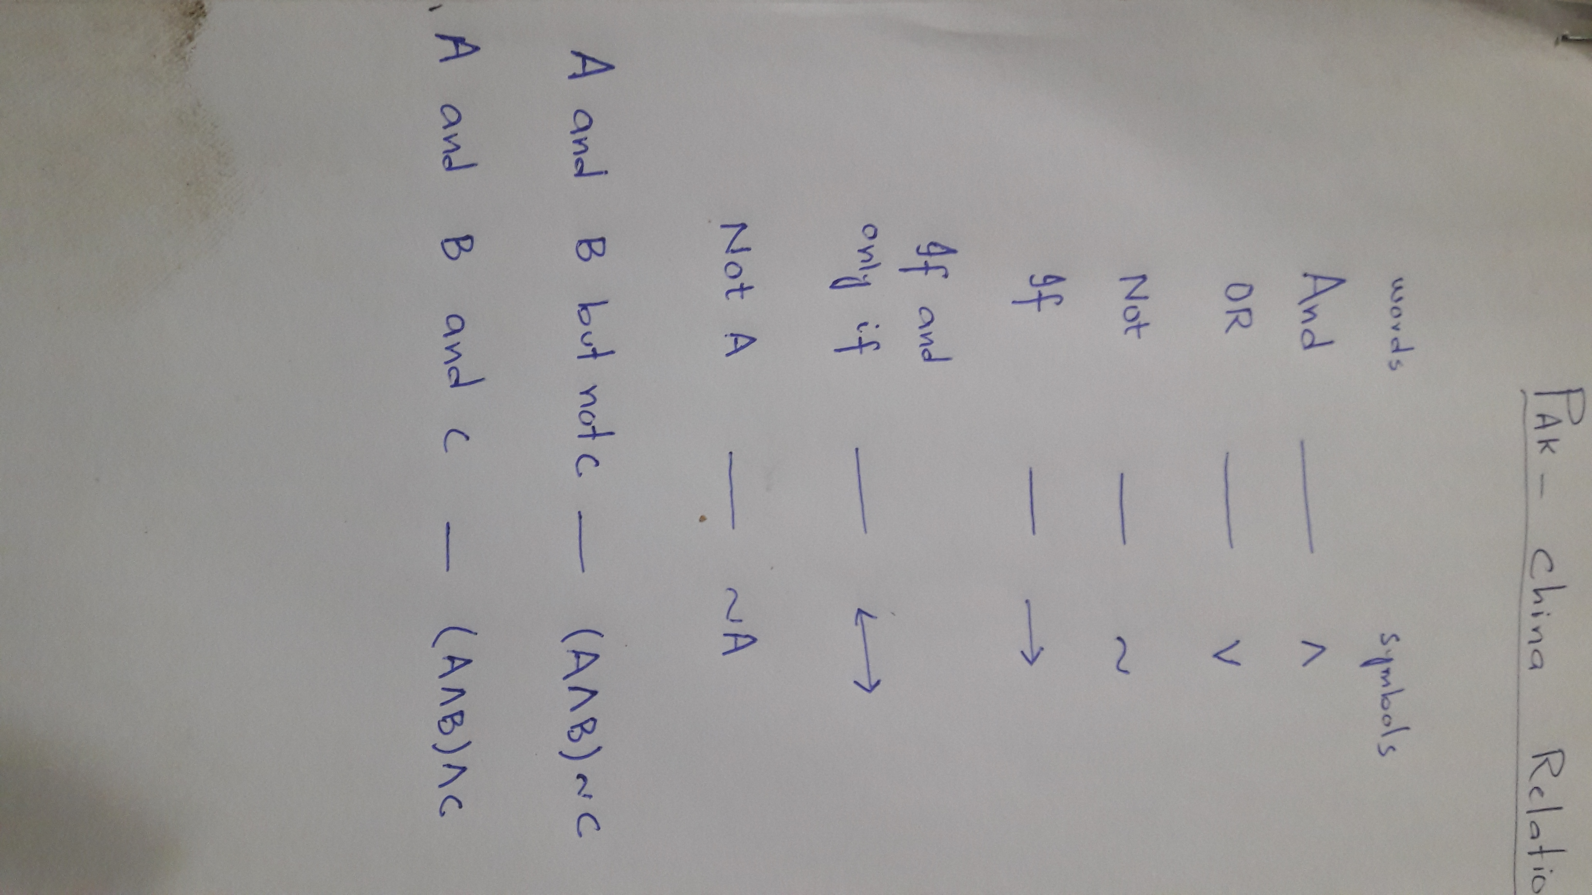
Some Logical Symbols and their use

Slide 18
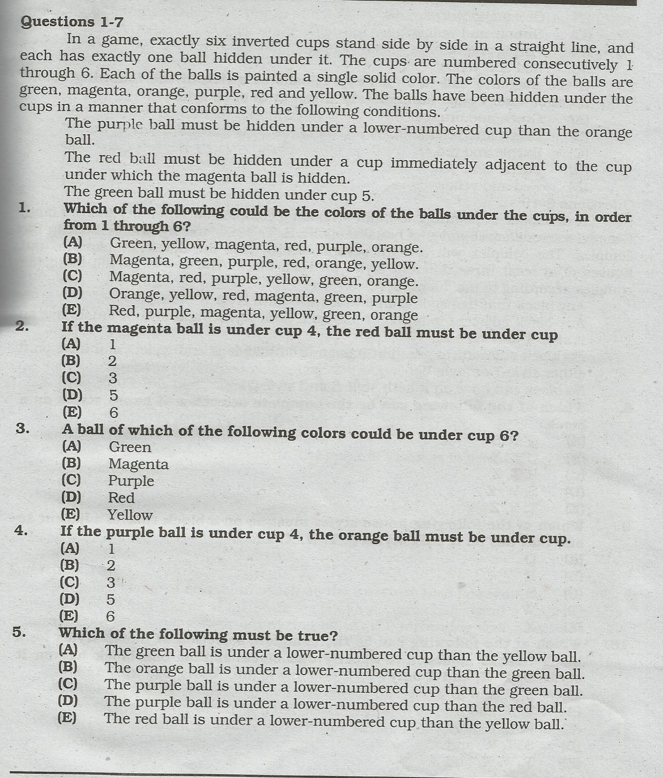

Slide 20
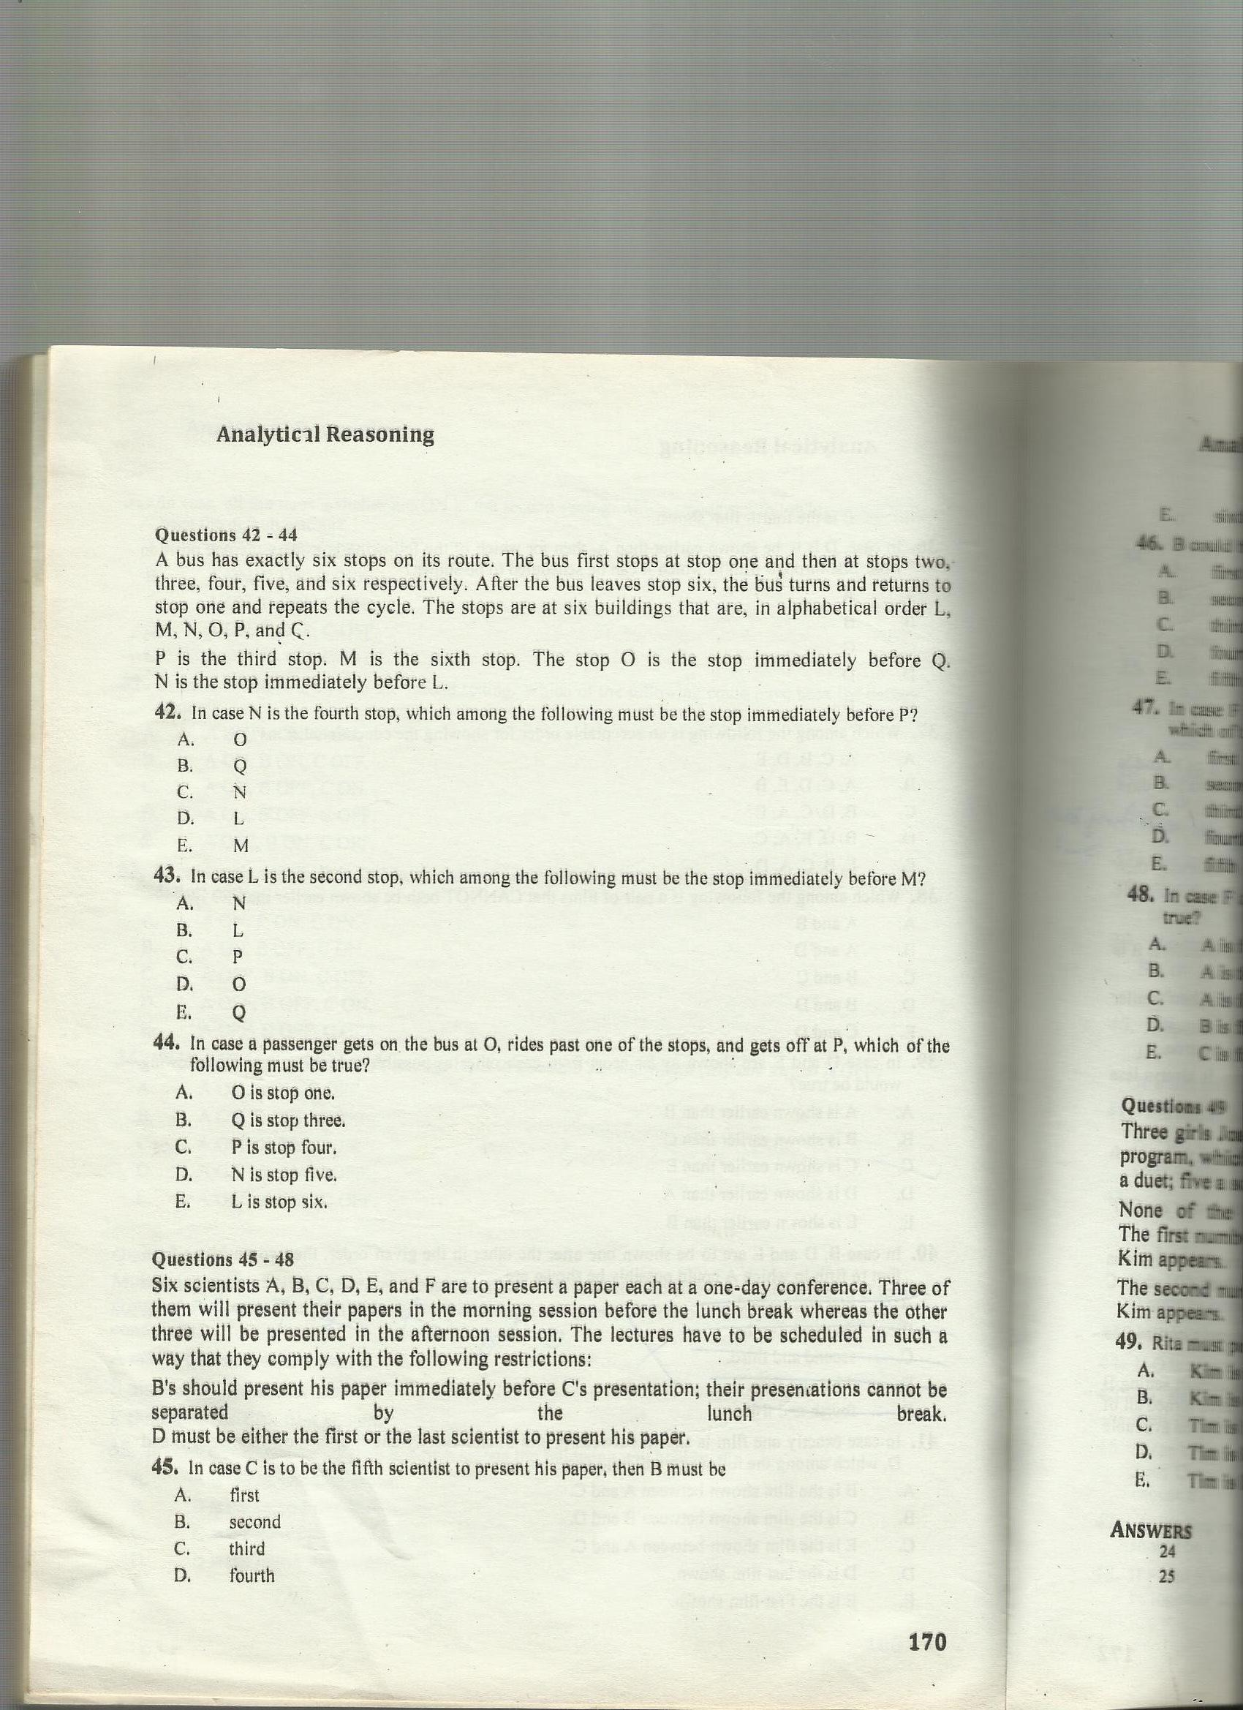

Slide 21
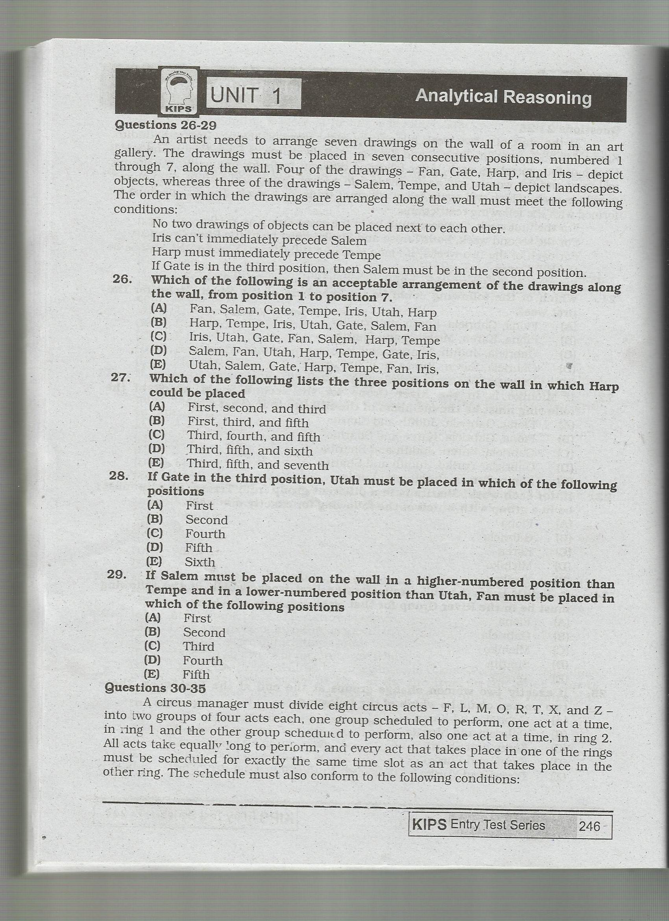

Slide 23
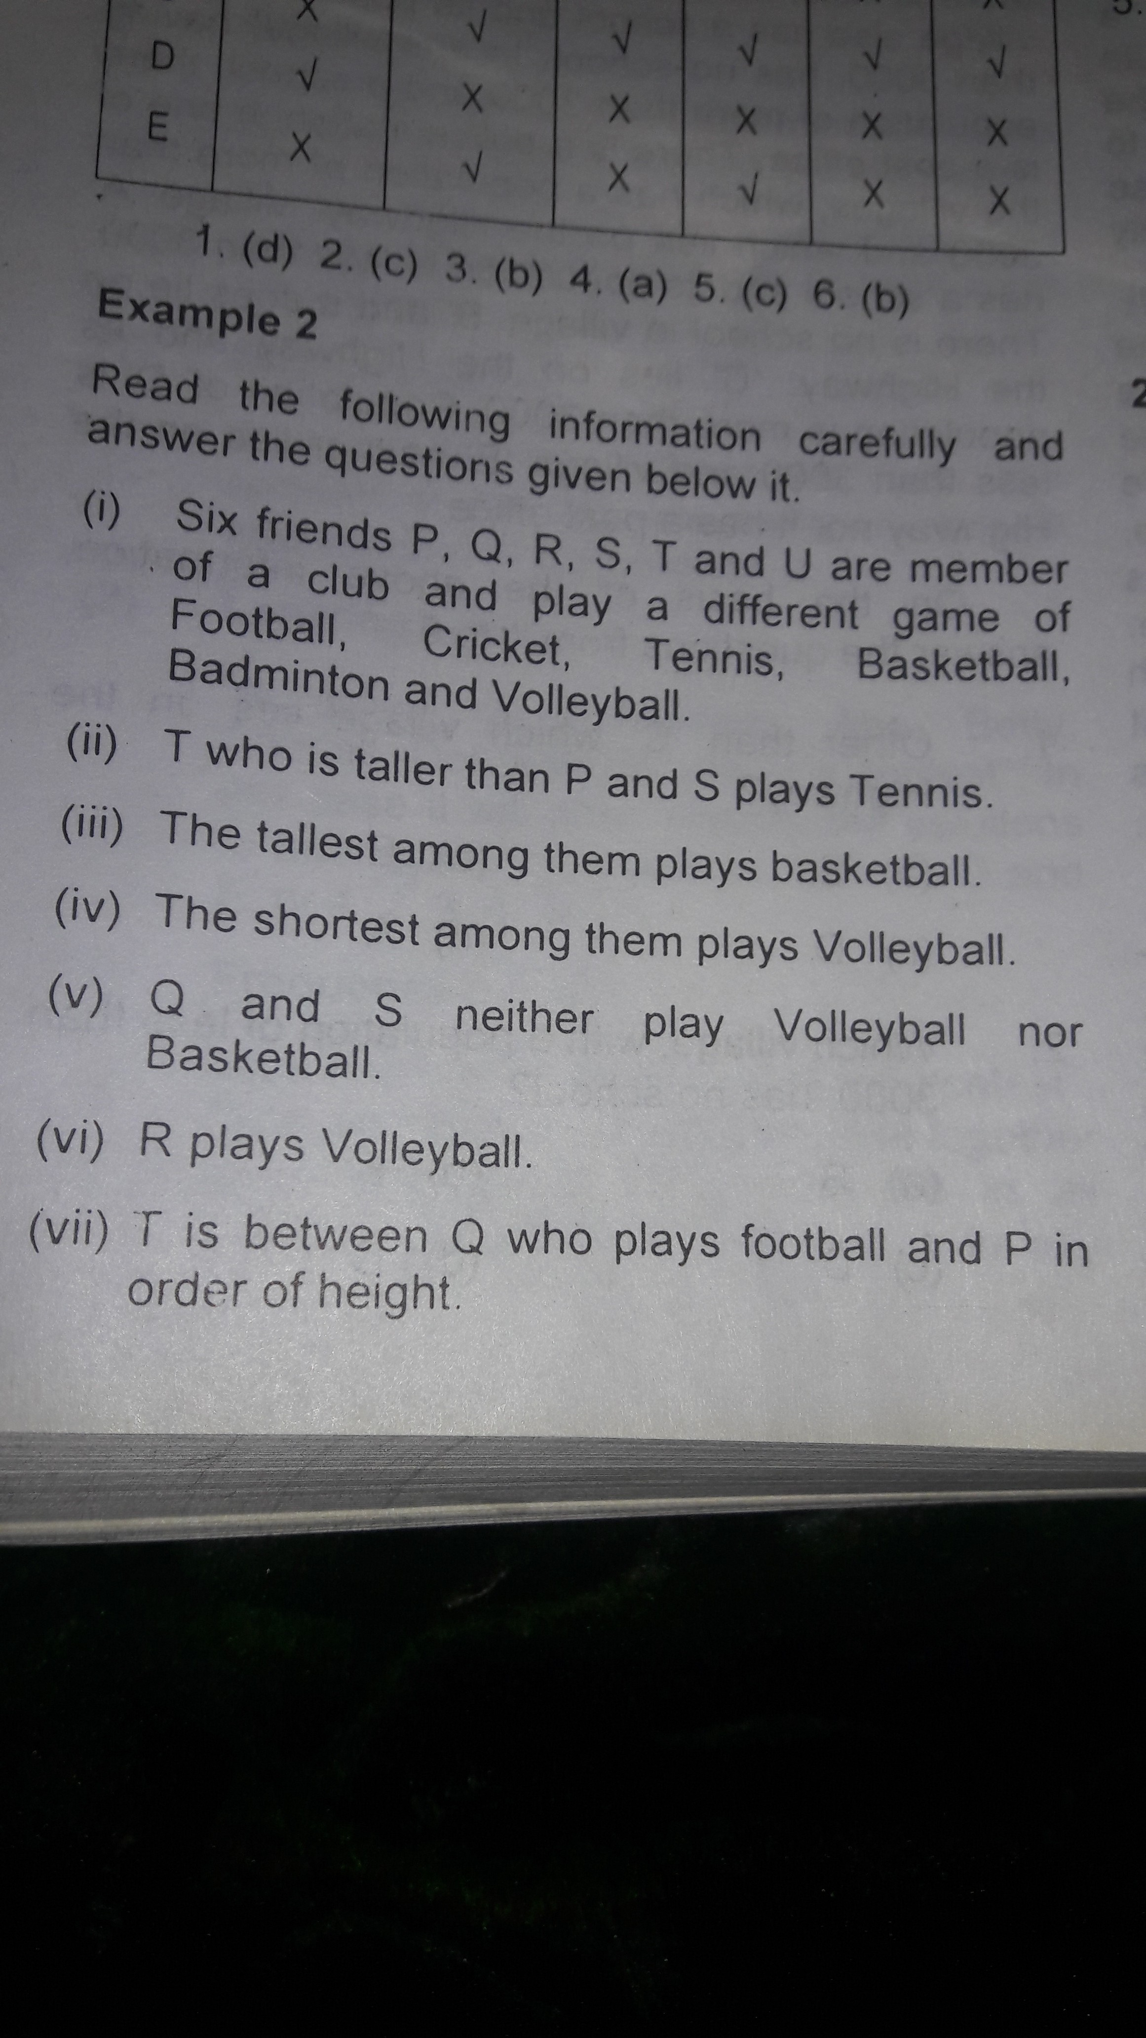

Slide 24
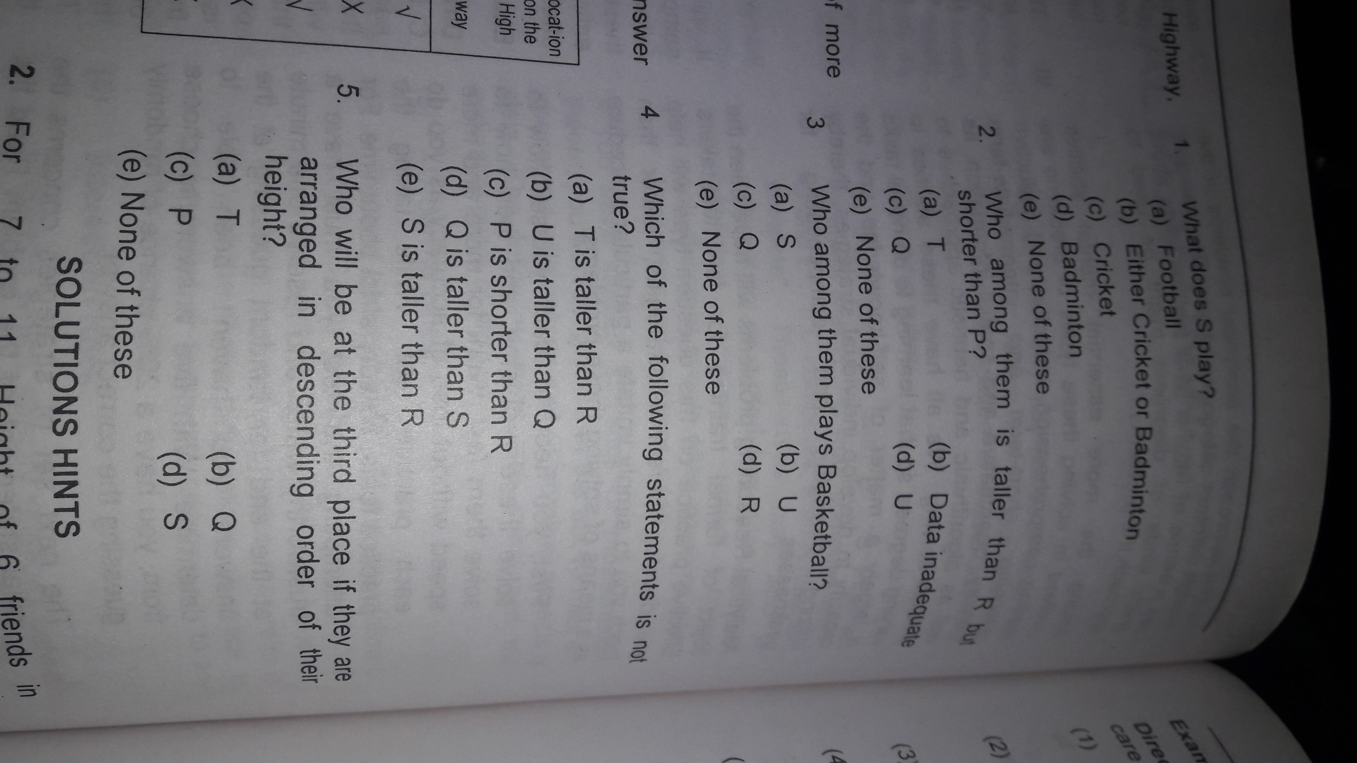

Slide 26
Thank You

